Slide 1
Energy oriented benchmarking of ML applications
Michalis Kasioulis, UCY, ESR2

Slide 2
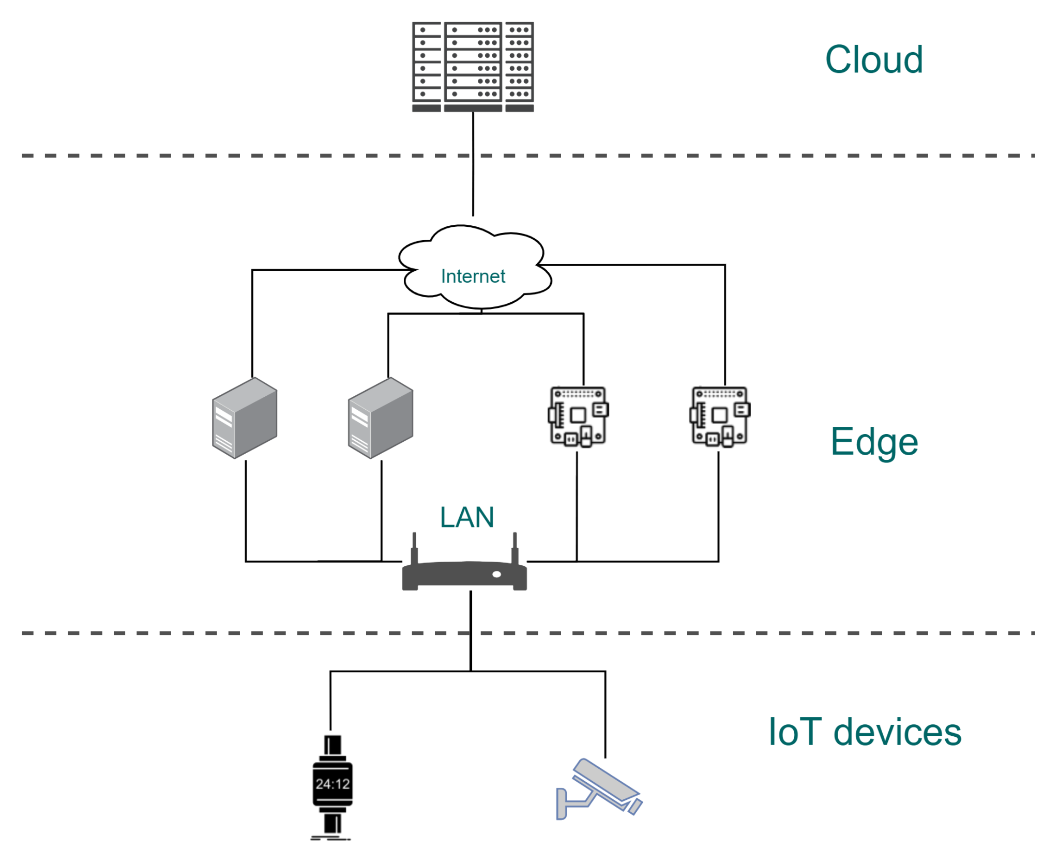
Motivation
Proliferation of IoT devices led to the development of edge computing, a new computing paradigm
Computation on edge is constantly growing
Typically ML workloads are energy hungry and require low response times
There is need for understanding the energy requirements of ML workloads when running on devices with heterogeneous hardware characteristics

Slide 3
Workloads

Slide 4
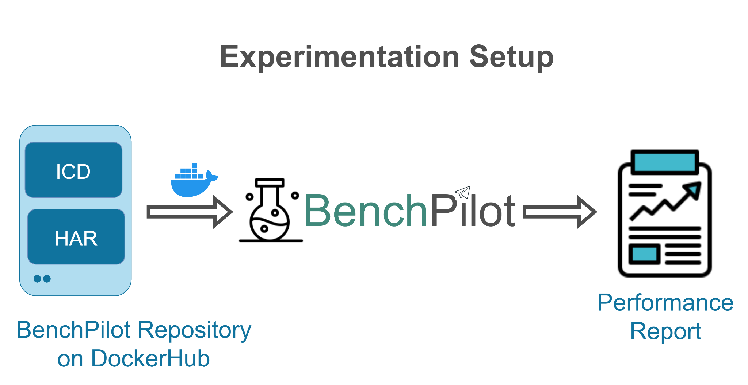
Experiments - Use Cases & Setup
ICD using MobileNet as a model, on the same device with different backends (PyTorch, ONNX, Tensorflow, Tensorflow Lite)
ICD using ONNX as backend, on the same device with different models (resnet50, mobilenet, ssd-mobilenet, ssd-resnet34)
Use cases 1 and 2 on a different device
HAR using the Pytorch backend on different devices

Slide 5
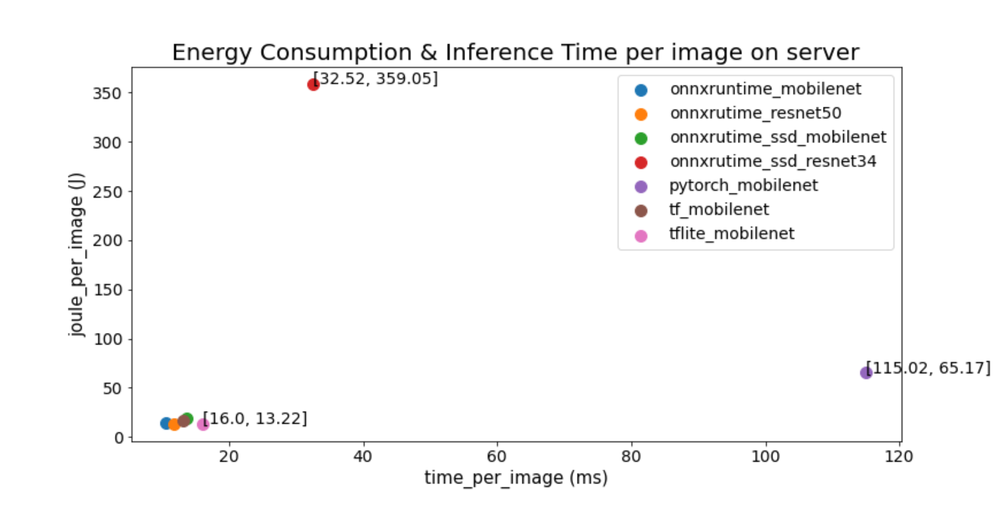
Results for Image Classification & Detection

Slide 6
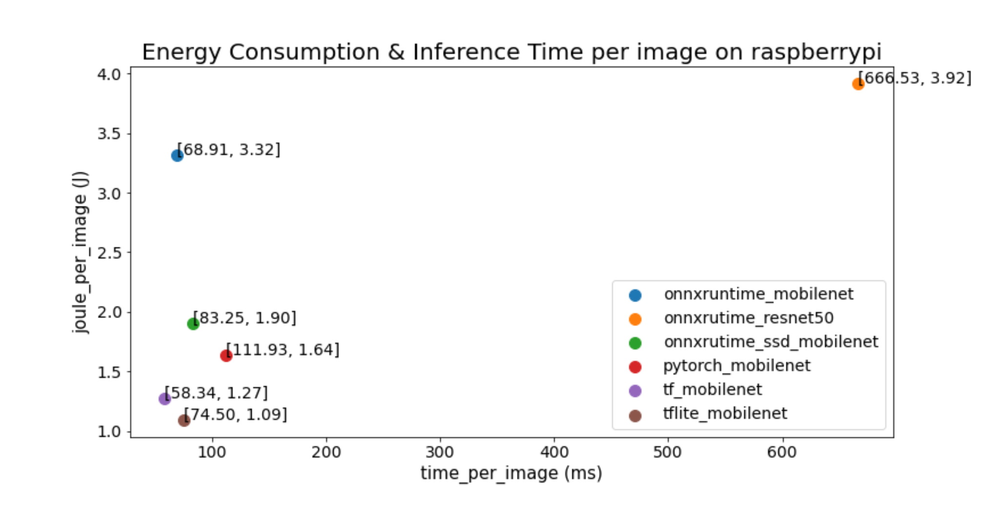
Results for Image Classification & Detection

Slide 7
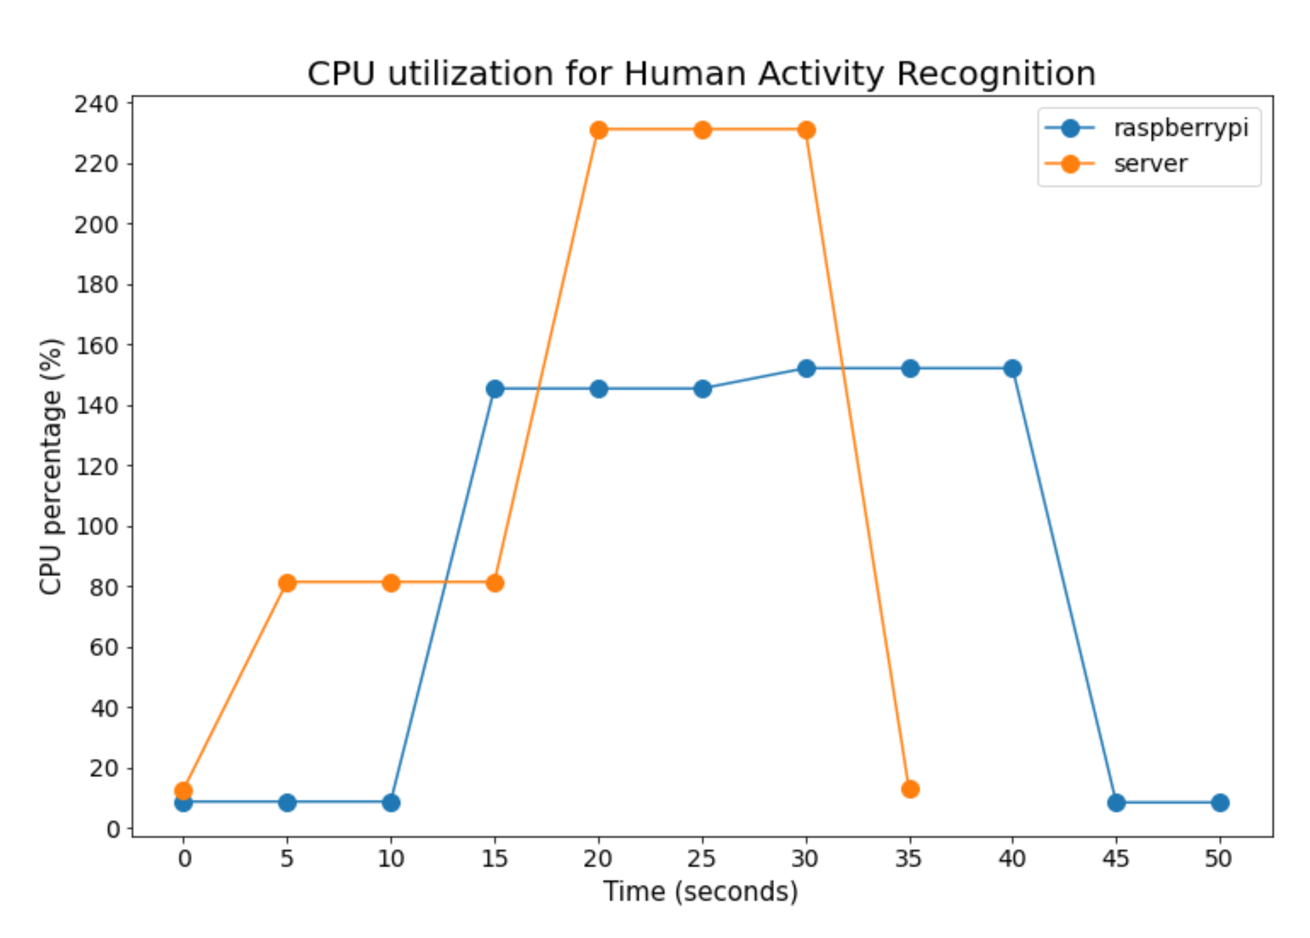
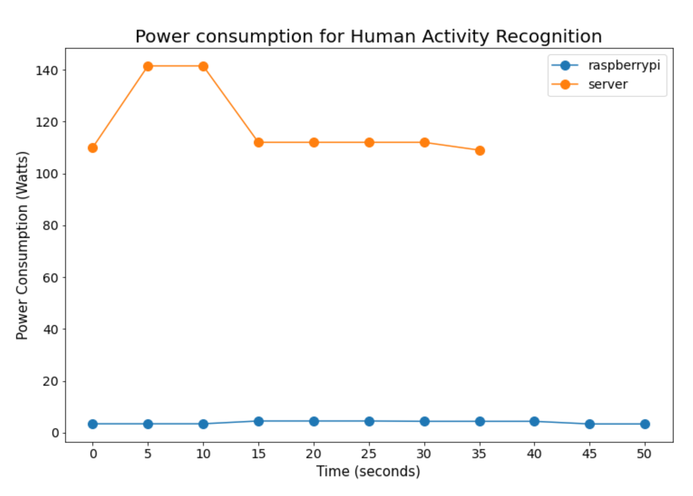
Results for Human Activity Recognition

Slide 8
Conclusions & Future Work
For ICD, the choice of model and backend affects the energy consumption and inference time per image
For ICD, the energy consumption is much lower on Raspberry Pi while inference time is at least 6 times higher in most of the cases
For ICD, PyTorch as a backend affects the performance metric and ssd-resnet34 as a model affects the energy metric
For HAR, the total inference time was around 4 times higher on Raspberry Pi while energy consumption of the server was more than 5 times higher due to idle power
Future Work
Compare CPU vs GPU on server and edge devices
Examine ‘accuracy per joule’ metric for different models
Perform inference over the network
Study the training procedure of the models

Slide 9
Acknowledgement

